Slide 1

Optimized Learning with Virtual Reality Summer 2020
Codey Winslow
Dr. Philip Howard

Slide 2
Goal of the Project
Can VR teach industry skills?
Is it a cheap alternative to mocking expensive setups?

Slide 3
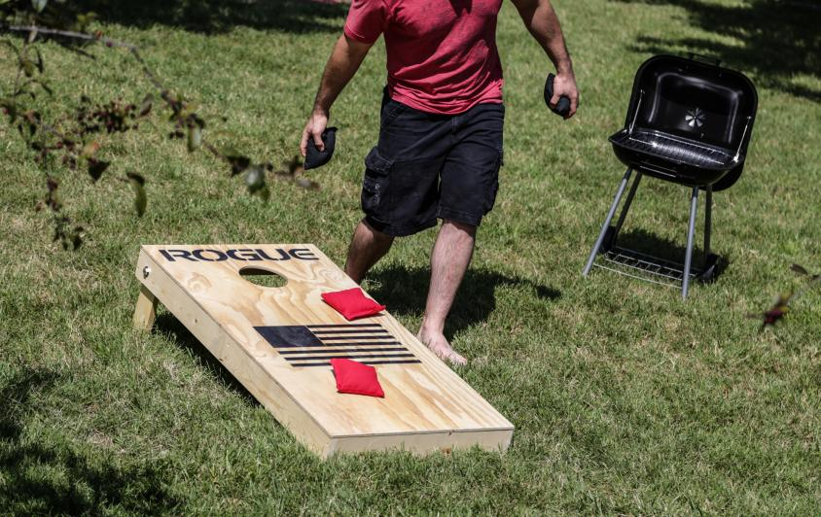
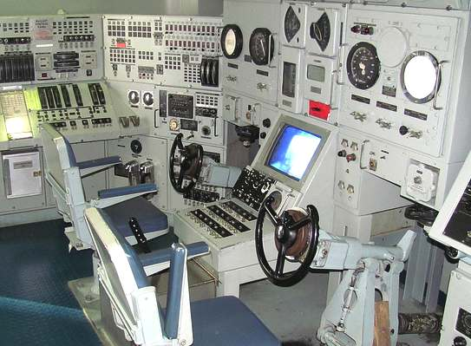
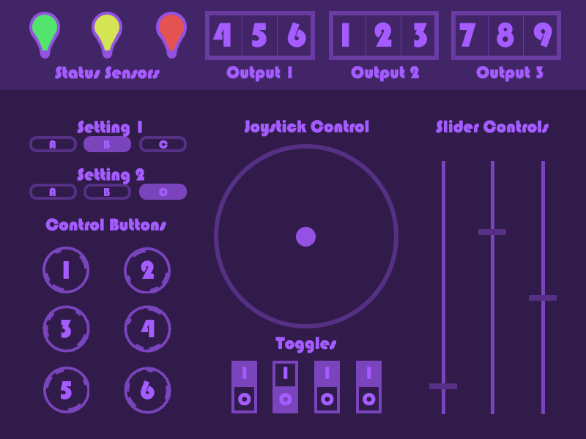
Plans for Execution
Initial
Cornhole
Procedure
Final
Touchscreen
3 Procedures
Simple
Intermediate
Advanced
2020 | Optimized Learning with Virtual Reality | Codey Winslow

Slide 4
Procedures
Level 1 – Rote Memorization
Level 2 – Enumerated Rote Memorization
Level 3 – Skill and Judgement
2020 | Optimized Learning with Virtual Reality | Codey Winslow

Slide 5
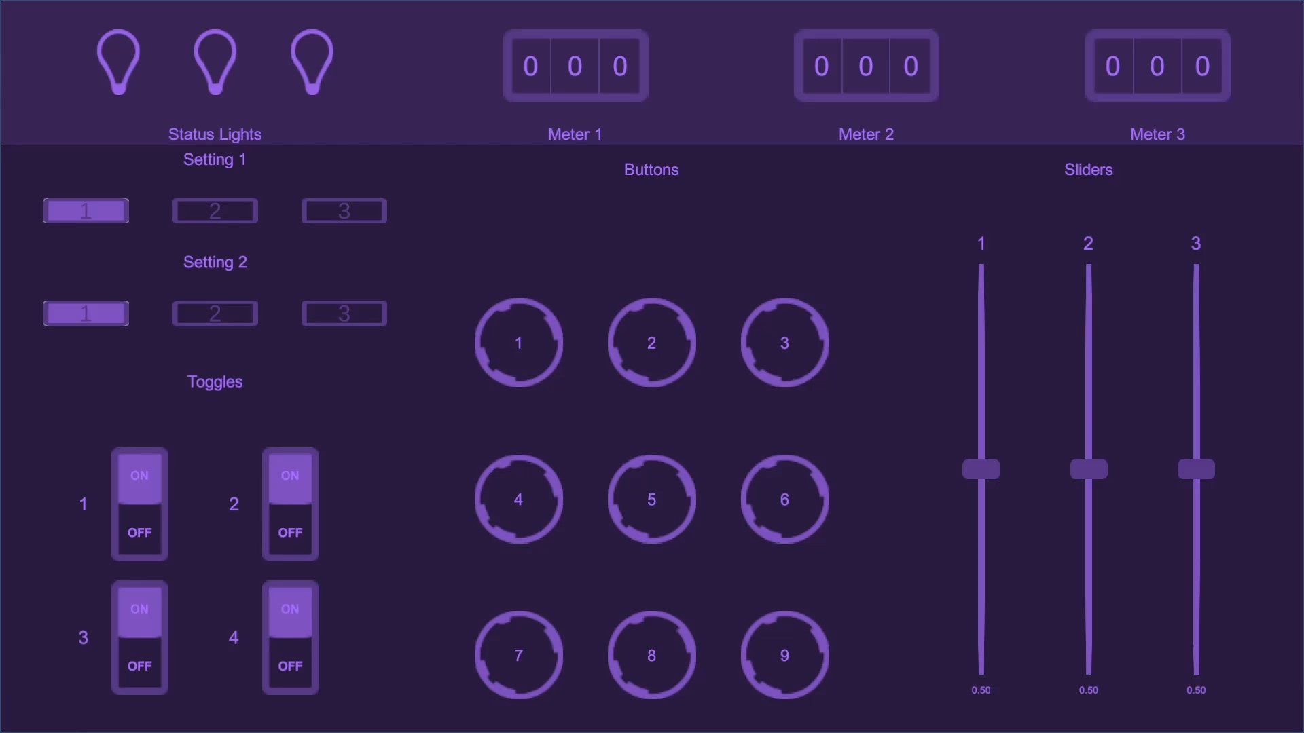
Procedures
Level 1 – Rote Memorization
1. Press button 1
2. Switch toggle 4
2020 | Optimized Learning with Virtual Reality | Codey Winslow

Slide 6
Procedures
Level 2 – Enumerated Rote Memorization
Green light
= sequence 1
Yellow light
= sequence 2
Red light
= sequence 3
2020 | Optimized Learning with Virtual Reality | Codey Winslow

Slide 7
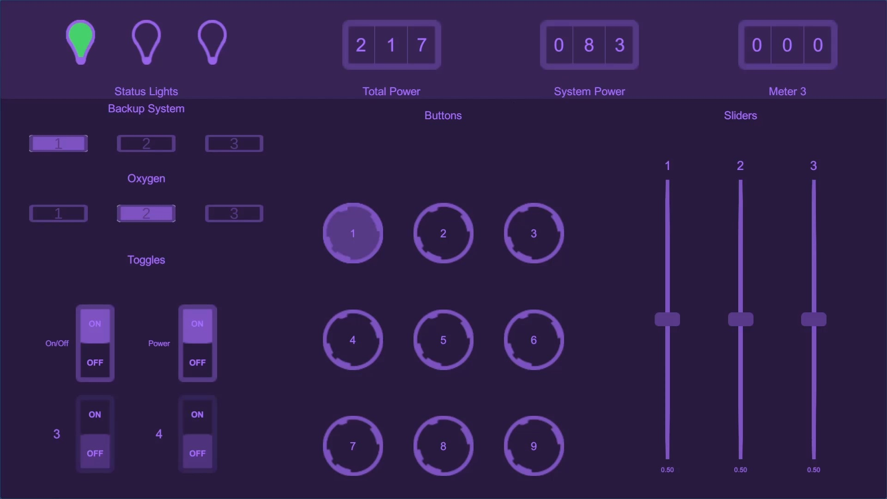
Procedures
Remaining Power
Level 3 – Skill and Judgement
Required Power
System group
View system
Turn on/off
2020 | Optimized Learning with Virtual Reality | Codey Winslow

Slide 8
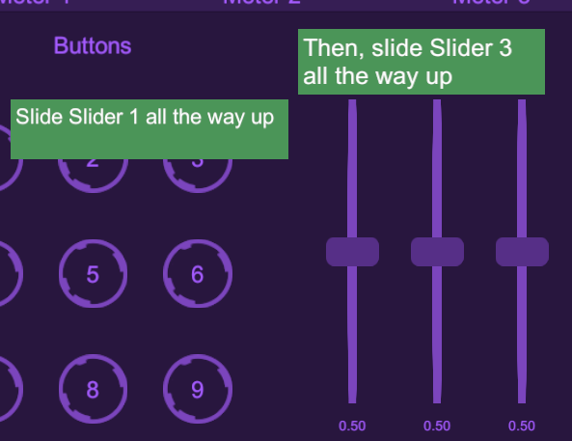
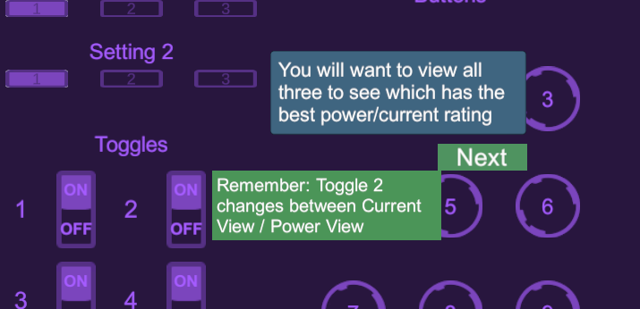
Tutorials
Hints for what to do next
Next buttons to move on

Slide 9

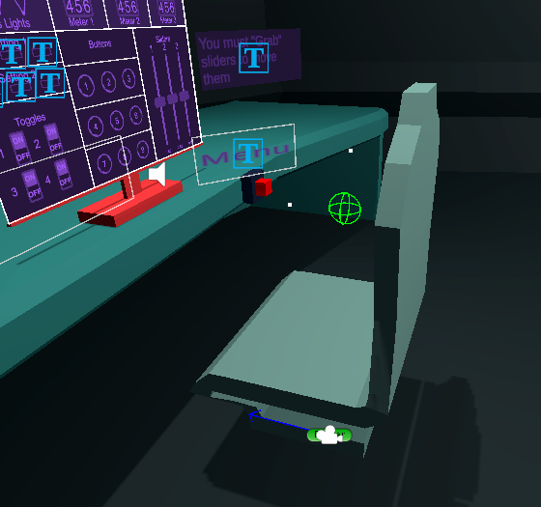
Implementing VR Behavior

Slide 10
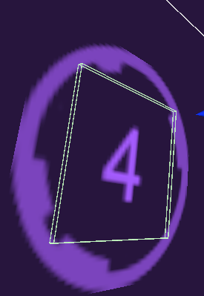
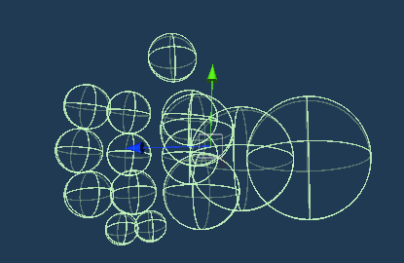
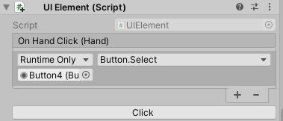
Implementing VR Behavior - Touchscreen
Touchscreen Button Collider
Hand colliders
Component captures hand collision

Slide 11

Testing
“Where is the ‘next’ option?”
- my Dad

Slide 12

Testing

Slide 13
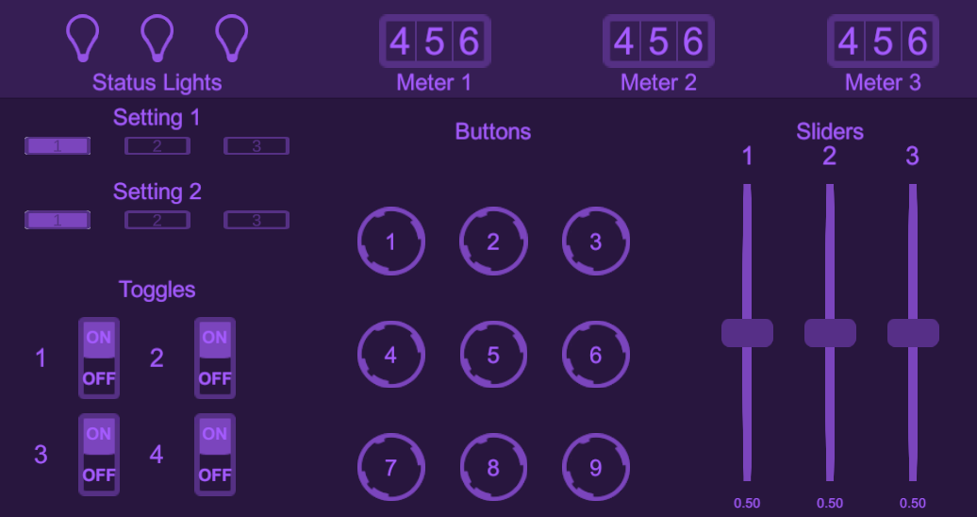
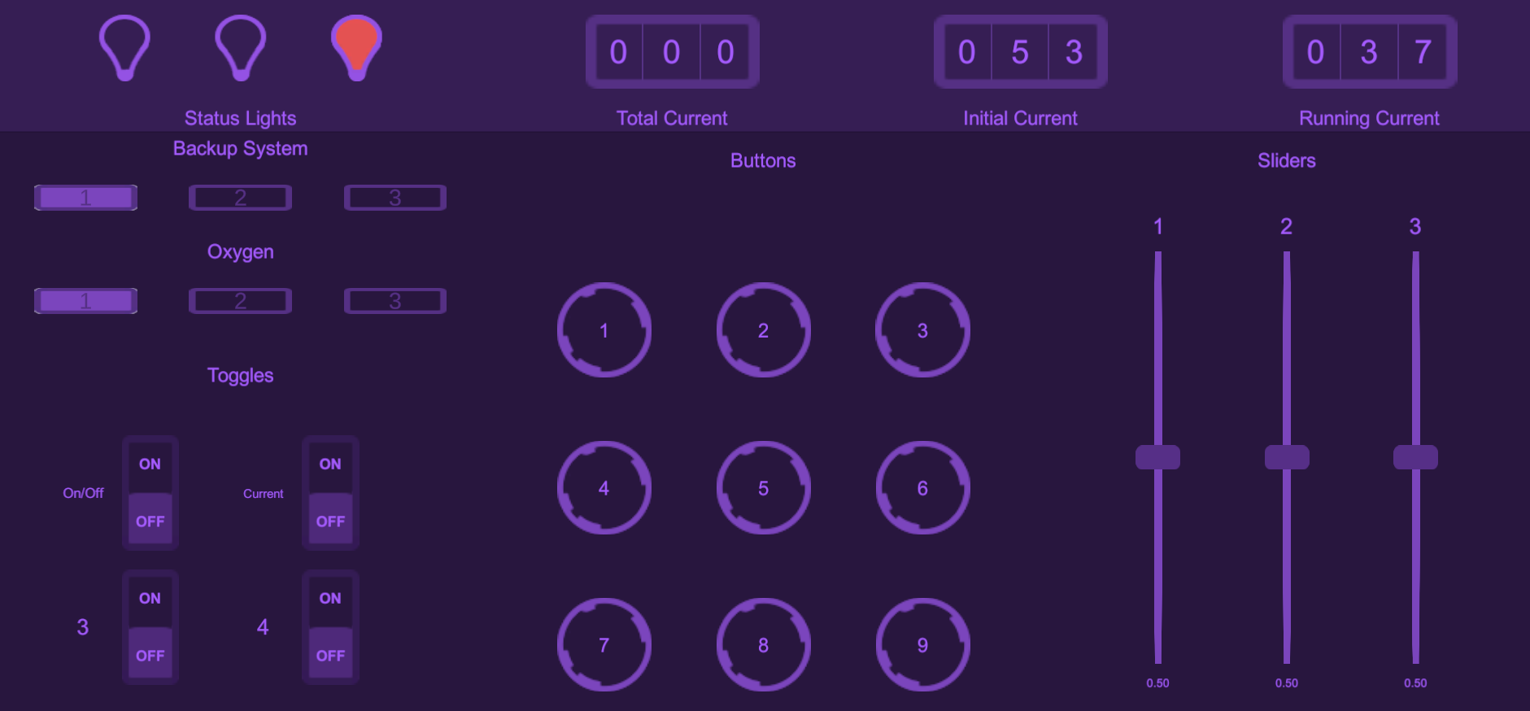
Testing
Not descriptive
More helpful

Slide 14
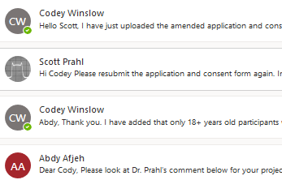
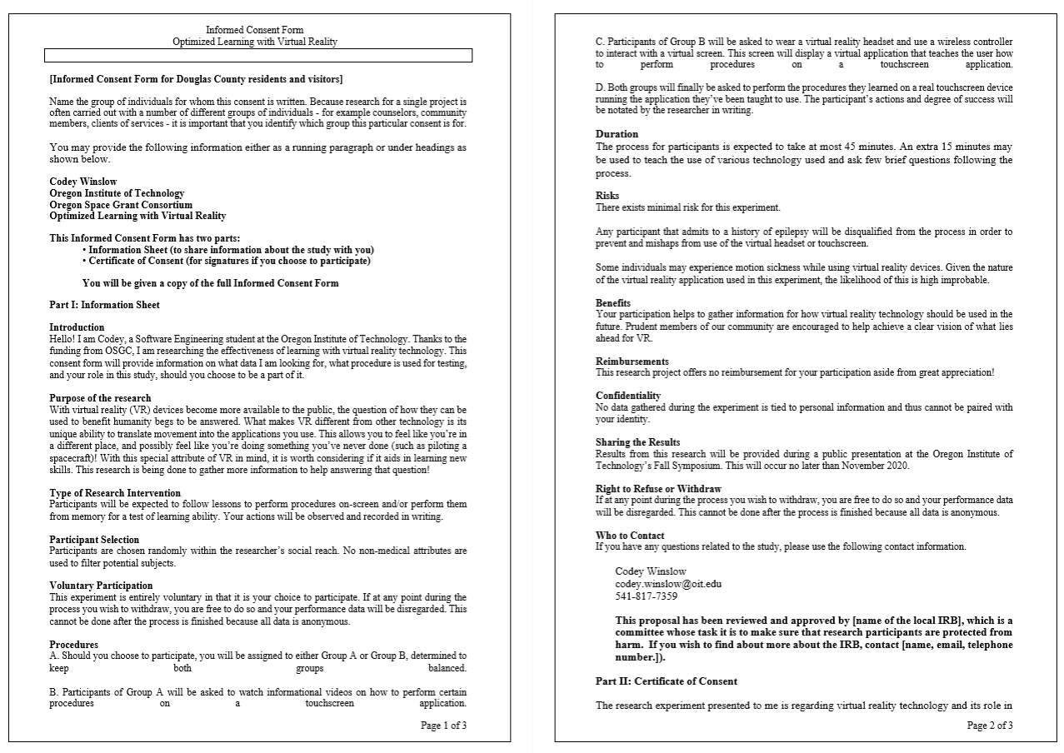
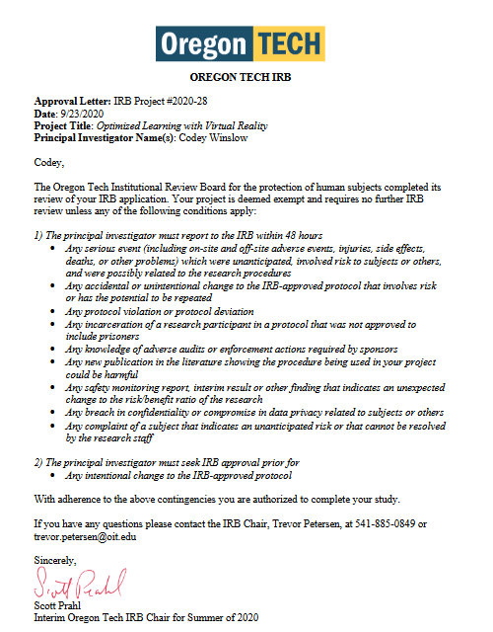
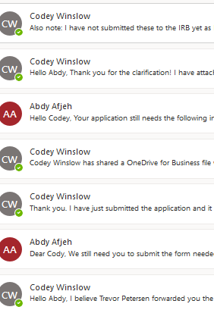
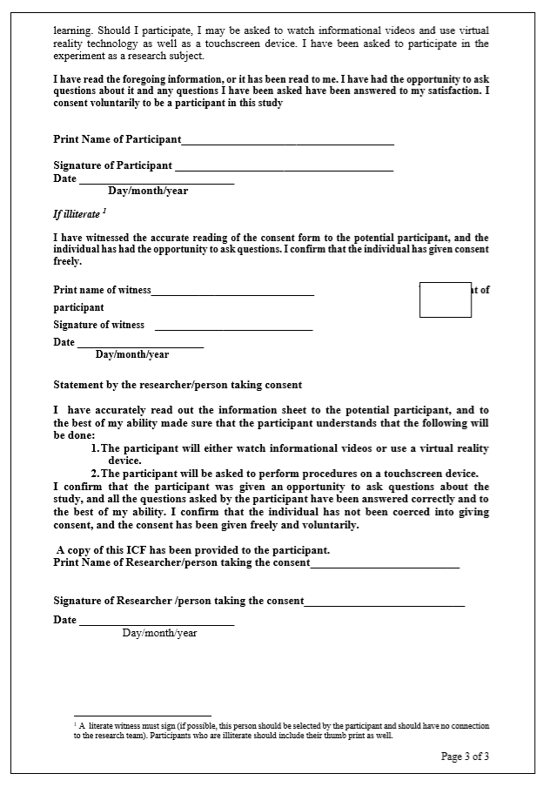
Human Subject Approval
2 weeks of emailing
Informed Consent Form
Approval/Exempt

Slide 15
Where Does VR Make Sense?
We must dive deeper:
Can physical skills be learned better in VR?
So far:
VR makes immersion and interaction cheap
Problems that require this would likely benefit

Slide 16
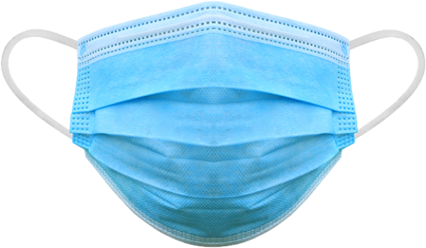
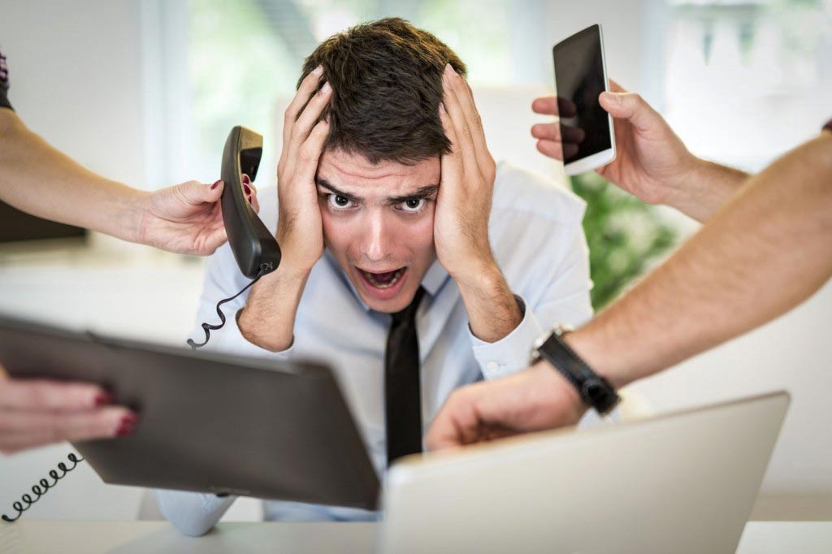

Worthwhile Experience
Deal with distractions
Build focusing skills

Slide 17
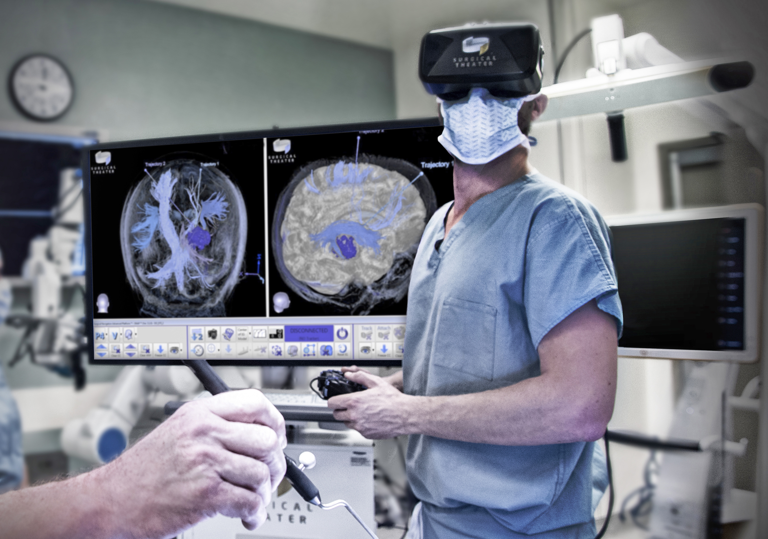

What Lies Ahead
What potential does VR technology hold?

Slide 18
Thanks for coming!
Questions?
Contact me at codey.winslow@oit.edu

